Slide 1
Vehicle Stability Control with Independent Hub/Wheel Drive System using optimal control-allocation based torque distribution
Group - 2
Ajay Krishnan
MS Student, CU-ICAR
akrish2@clemson.edu
Ashwin Kumar Rangarajan
MS Student, CU-ICAR
rangar2@clemson.edu

Slide 2
Phase – I (Recap)

Slide 3
Objective
Optimal Control-Allocation: Utilize techniques like LQR, MPC or Sliding Mode for precise torque distribution.
Control System Architecture: Integrated/Hierarchical architecture for efficient torque management.
Control Strategy: Fix variables for dynamic torque adjustment and stability enhancement.
Torque Distribution Layer: Implement real-time torque optimization for improved stability.
Allocation Strategy: Use techniques like PID, Quadratic Programming for optimal torque allocation.
Simulation Studies: Evaluate in MATLAB, Simulink, and CARSIM for diverse maneuvers.
Stability Assessment: Measure performance across maneuvers to validate improvements.
Publication: Share findings in academic forums to contribute to vehicle dynamics control.

Slide 4
Literature Review (Consolidated)
Gao F, Zhao F, Zhang Y. Research on Yaw Stability Control Strategy for Distributed Drive Electric Trucks. Sensors (Basel). 2023 Aug 17;23(16):7222. doi: 10.3390/s23167222. PMID: 37631758; PMCID: PMC10459129.
Karogal, I. and Ayalew, B., "Independent Torque Distribution Strategies for Vehicle Stability Control," SAE Technical Paper 2009-01-0456, 2009, https://doi.org/10.4271/2009-01-0456
Zhai, L., Wang, C., Zhang, X., Hou, R., Mok, Y.M., Hou, Y.: Handling stability control strategy for four-wheel hub motor-driven vehicle based on adaptive control for road adhesion. IET Intell. Transp. Syst. 16, 586–601 (2022). https://doi.org/10.1049/itr2.12159
Hou R, Zhai L, Sun T. Steering Stability Control for a Four Hub-Motor Independent-Drive Electric Vehicle with Varying Adhesion Coefficient. Energies. 2018; 11(9):2438. https://doi.org/10.3390/en11092438
Peng, B. , Zhang, H. and Zhao, P. (2017) Research on the Stability Control Strategy of Four-Wheel Independent Driving Electric Vehicle. Engineering, 9, 338-350. doi: 10.4236/eng.2017.93018
Liu, J., Weng, H., Hu, Y. et al. Driver-in-the-Loop Handling Stability Control of 4WID-EV. Int.J Automot. Technol. 23, 345–356 (2022). https://doi.org/10.1007/s12239-022-0032-z
L. Zhai, C. Wang, Y. Hou and C. Liu, "MPC-Based Integrated Control of Trajectory Tracking and Handling Stability for Intelligent Driving Vehicle Driven by Four Hub Motor," in IEEE Transactions on Vehicular Technology, vol. 71, no. 3, pp. 2668-2680, March 2022, doi: 10.1109/TVT.2022.3140240

Slide 5
Methodology
Direct Yaw Moment Control (DYC) strategy is adopted.
Hierarchical control system with upper and lower controllers, alongside a speed controller.
Actual vehicle modeled with a 2-degree-of-freedom (2-DOF) approach.
Error states compared for body slip angle, yaw rate, lateral acceleration, and speed.
Speed controller operates using PID control with speed error as input and traction force as output.
Upper controller corrects yaw moment based on errors in yaw rate, body slip angle, and lateral acceleration.
Lower-level controller allocates corrective torque to wheels based on inputs from PID and upper controller.

Slide 6
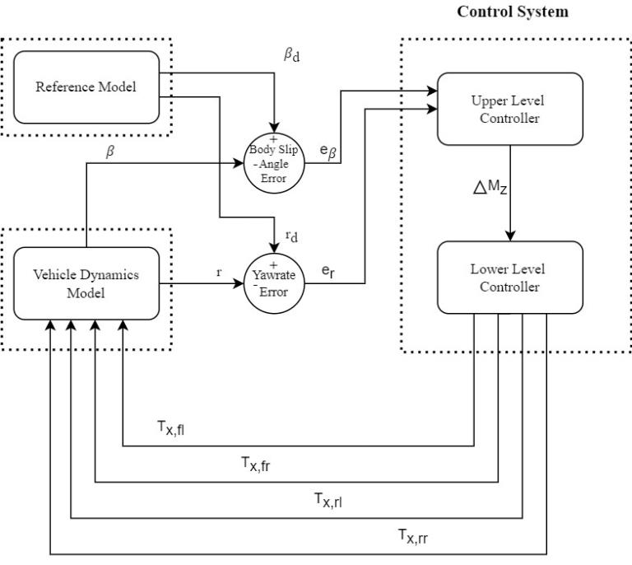
Overall System Model (Updated)

Slide 7
Assumptions
The vehicle is front wheel steered
The steer angle on the left and right wheels are identical
Vehicle is a rigid body and no-load transfer due to the suspension system
Linear tire model for lateral force considerations
Body slip and steer angles are assumed to be small for approximations
Road surface is flat and without any banking
All maneuvers are performed at constant speed

Slide 8
Vehicle Dynamics Model
Vehicle model is taken as a simple 2-DOF system
Yaw rate and Body slip angle are the states and steer angle is the input
Outputs from this model include yaw rate, body slip angle, lateral acceleration, longitudinal speed, position in X and Y axes w.r.t inertial frame of reference
Weight transfer along the longitudinal and lateral axes is considered due to vehicle cornering
The equations governing the system are as follows

Slide 9
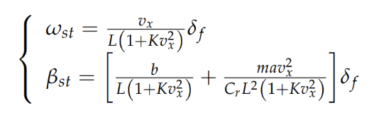
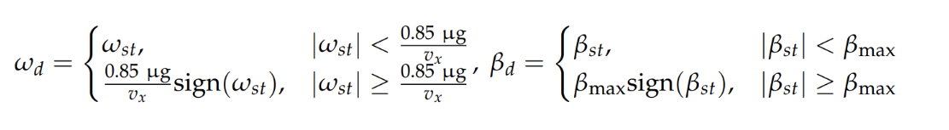
Reference Vehicle Model
The steady state gain values of the 2-DOF model are taken as the desired values for computing errors
The upper and lower bounds are set according to the friction limit and non-linear behavior of the 2-DOF bicycle model

Slide 10



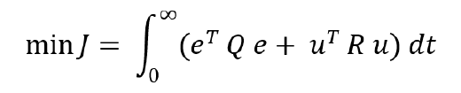
Upper-Level Control Design
The upper layer takes in the error values from body slip angle and yaw rate and sends out the corrective yaw moment
Linear Quadratic Method is employed for optimizing the objective function
The weighting matrix Q and R are for the error states and the control effort respectively
They are set according to the level of control refinement required
Accordingly, the optimal value of K is computed, and the control signal (Input – U) is sent to the lower-level controller
The equations which govern the controller is given by,
Error States:
Objective Function:
5. Control Signal Equation
3. Weighting Matrices
4. Algebraic Riccati Equation

Slide 11
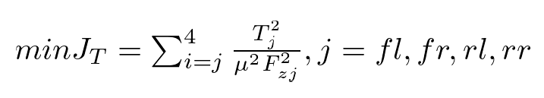
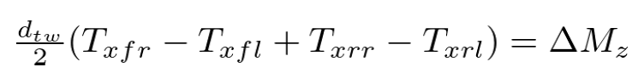
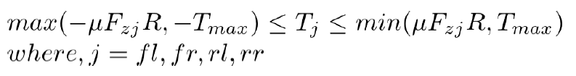
Lower-level Control Design
The primary role of the lower-level controller is to translate the received input to the individual wheel/hub motors as corrective torque commands
This controller receives the corrective yaw moment from the upper-layer controller
As the objective function is quadratic and the restraint conditions are linear, quadratic programming method is used over LQR to minimize the objective function
Objective function is chosen based on the friction ellipse which is to be minimized
The restraint condition is provided by the moment equation along the vehicle’s longitudinal axis
Upper and lower bounds are governed by maximum motor torque and road adhesion conditions and given by the below inequalities

Slide 12
Phase – II

Slide 13
Upper-Level Control Design
Since there isn't an analytical method available for parameter selection, we tuned the parameters based on our understanding of the system and optimization targets.
Trial and error method was carried out.
The parameters were optimized analyzing the corrective moment and torque value graphs
The tuned parameters for the Q and R matrix are as below,
Parameters | Value
q1 (Side Slip Angle) | 1
q2 (Yaw Rate) | 10
r1 (Corrective Yaw Moment) | 4.50E-07

Slide 14
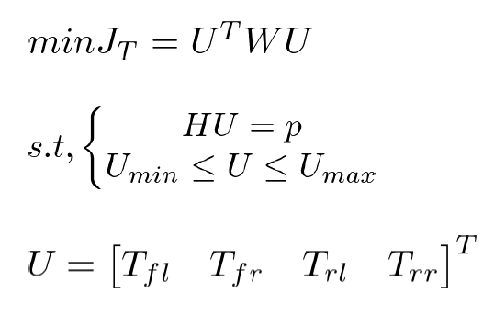
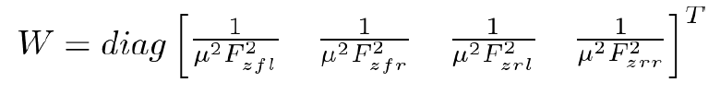


Lower-level Control Design (Contd.)
Quadratic Programming Optimization:
The above objective function, restraints and bounds are translated into a matrix form and the resulting U matrix is obtained

Slide 15
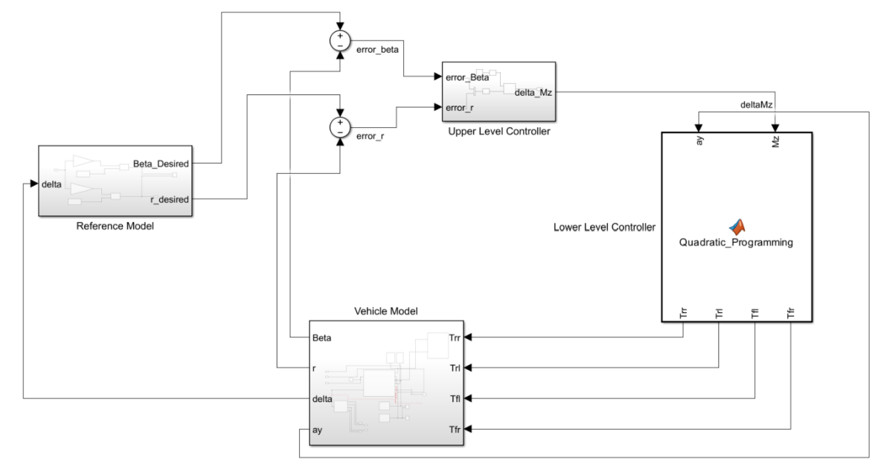
Simulink Model
The entire vehicle model and control system architecture is modeled in Simulink and MATLAB.

Slide 16
Results - Maneuvers and Comparison
Parameters considered for graphical analysis,
Different maneuvers (Steering Inputs) - Sine with dwell, Fishhook, J-Turn and Double lane change
Oversteer and Understeer conditions - By altering the values of values of weight distribution (a and b) and axle cornering stiffnesses (C1 and C2).
Comparison - Sideslip angle, yaw rate, lateral acceleration and trajectory followed with and without control system
Corrective motor torque at four wheels

Slide 17
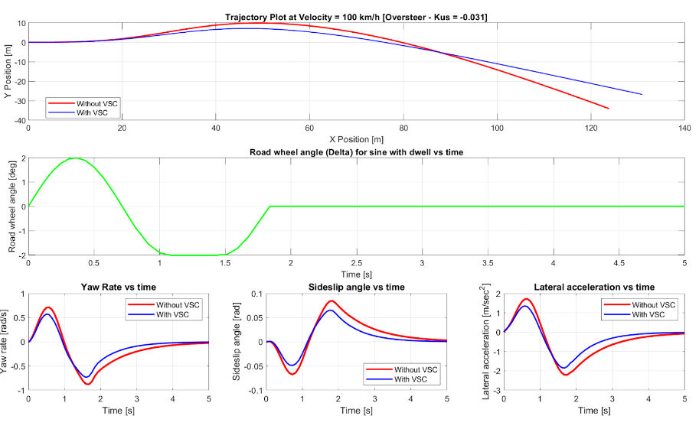
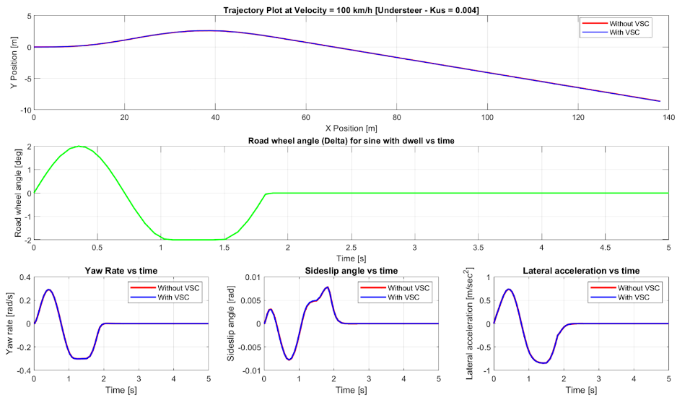
Sine with Dwell
Oversteer Vehicle
Understeer Vehicle
Significant difference observed in all the parameters
No significant difference observed in all the parameters

Slide 18
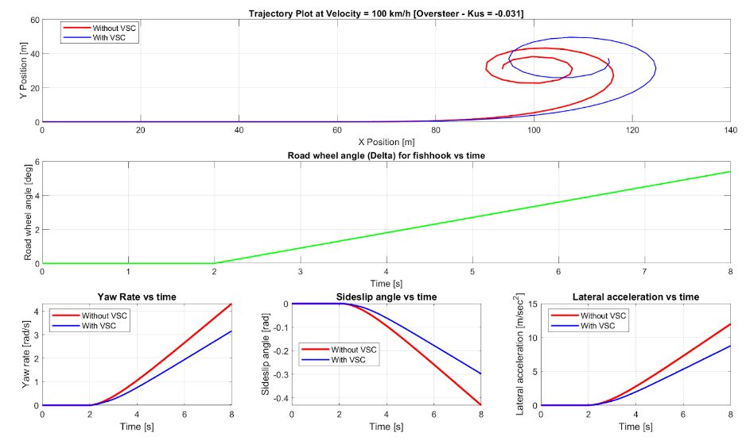
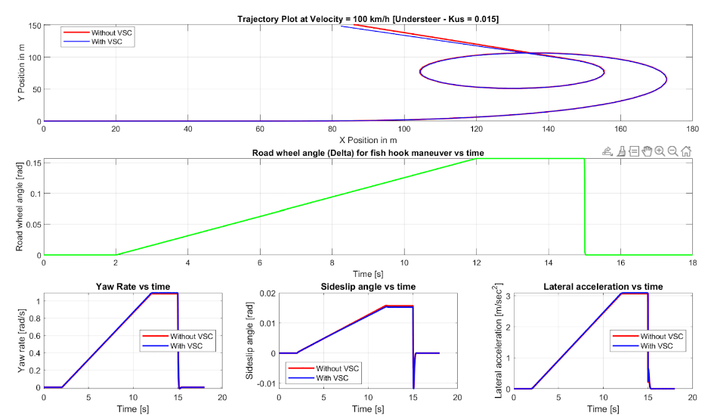
Fishhook maneuver
Oversteer Vehicle
Understeer Vehicle
Significant difference observed in all the parameters
Marginal difference observed in all the parameters

Slide 19
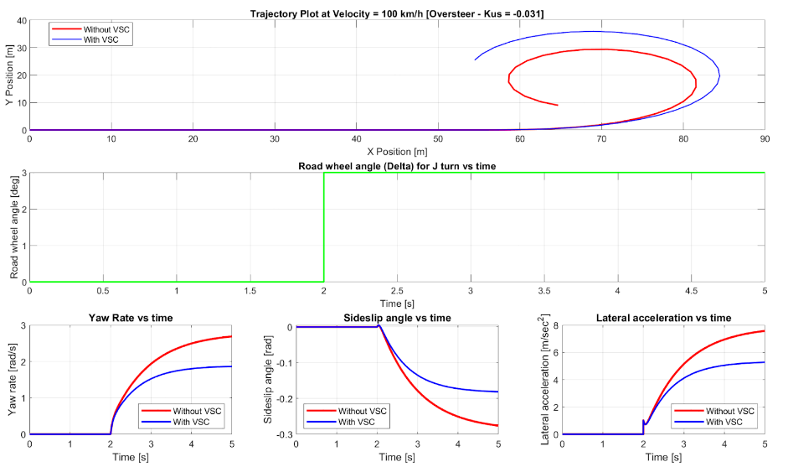
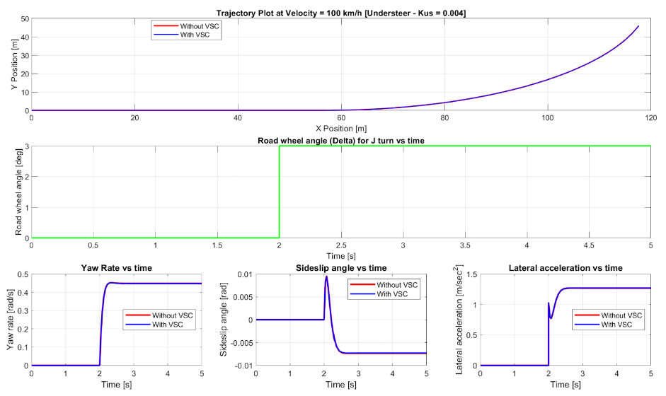
J-Turn
Oversteer Vehicle
Understeer Vehicle
Significant difference observed in all the parameters
No difference observed in all the parameters

Slide 20
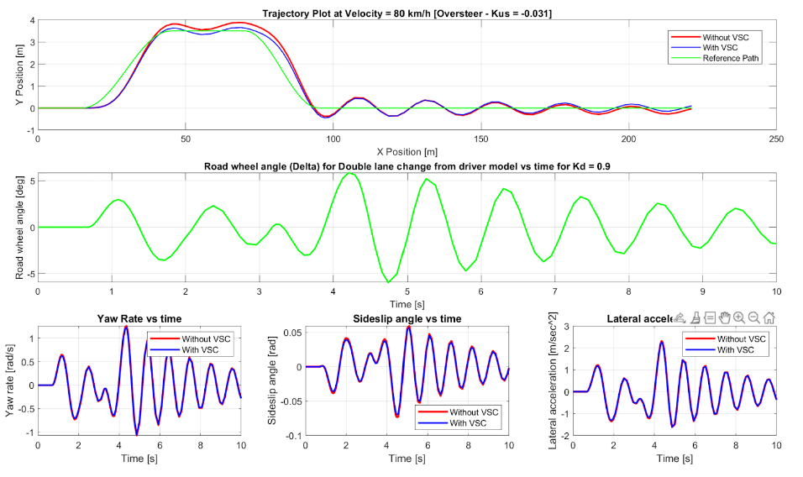
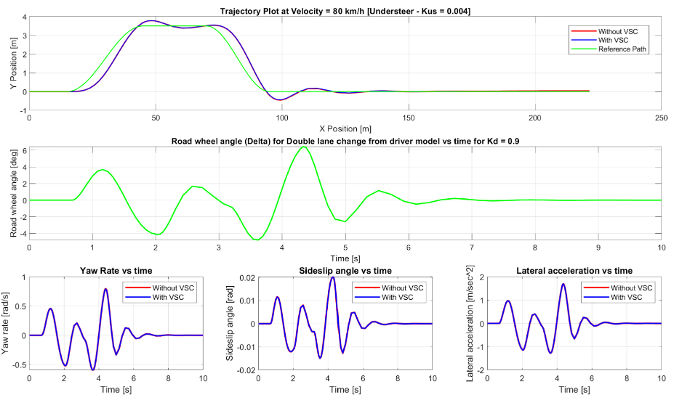
Double lane change maneuver
Oversteer Vehicle
Understeer Vehicle
Significant difference observed in all the parameters
No difference observed in all the parameters

Slide 21
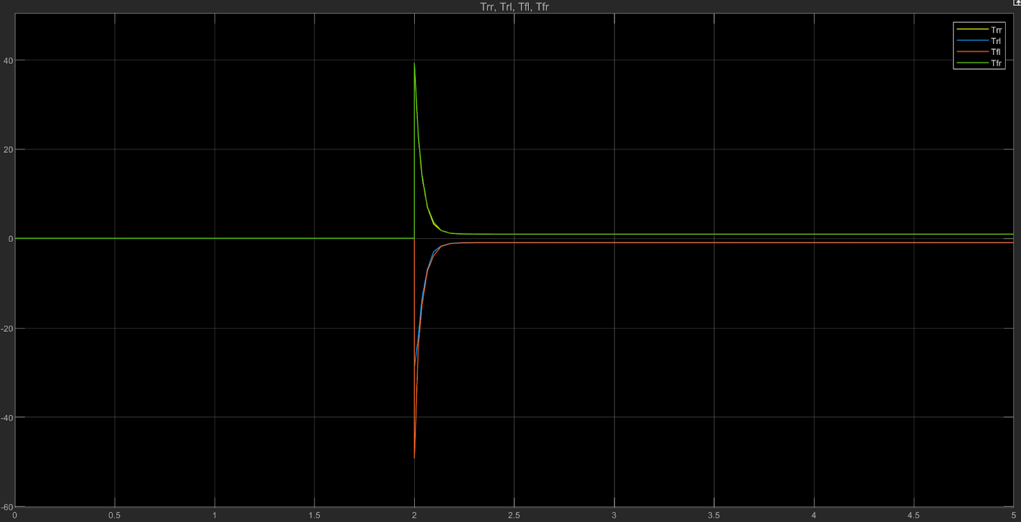
Corrective Torque Graph
Rear right and Front right torques
Rear left and
Rear right torques

Slide 22
Conclusion
The weighting matrices were tuned to the optimum values to achieve reasonable corrective moment and individual wheel motor torques.
The comparison graphs showed a significant improvement in oversteer and marginal improvement in understeer conditions of the control system performance.
The corrective torque commands also worked as expected in following the steer angle input
Model Upscaling for better performance:
The control system performance could be improved by choosing a higher DOF vehicle model and a non-linear tire model thereby providing leverage to the controller parameters
Another potential inclusion could be to carry out the maneuver simulations in different friction surfaces (Wet Asphalt, Wet basalt, Ice etc.) by monitoring friction co-efficient during the course of the simulation.

Slide 23
References
[1] Karogal, I. and Ayalew, B., "Independent Torque Distribution Strategies for Vehicle Stability Control," SAE Technical Paper 2009-01-0456, 2009, https://doi.org/10.4271/2009-01-0456
[2] Gao F, Zhao F, Zhang Y. Research on Yaw Stability Control Strategy for Distributed Drive Electric Trucks. Sensors (Basel). 2023 Aug 17;23(16):7222. doi: 10.3390/s23167222. PMID:
37631758; PMCID: PMC10459129.
[3] L. Zhai, C. Wang, Y. Hou and C. Liu, "MPC-Based Integrated Control of Trajectory Tracking and Handling Stability for Intelligent Driving Vehicle Driven by Four Hub Motor," in IEEE Transactions on Vehicular Technology, vol. 71, no. 3, pp. 2668-2680, March 2022, doi: 10.1109/TVT.2022.3140240.
[4] Liu, J., Weng, H., Hu, Y. et al. Driver-in-the-Loop Handling Stability Control of 4WID-EV. Int.J Automot. Technol. 23, 345–356 (2022). https://doi.org/10.1007/s12239-022-0032-z
[5] Han, Zhongliang & Xu, Nan & Chen, Hong & Huang, Yanjun & Zhao, Bin, 2018. "Energy-efficient control of electric vehicles based on linear quadratic regulator and phase plane analysis," Applied Energy, Elsevier, vol. 213(C), pages 639-657
[6] Peng, B. , Zhang, H. and Zhao, P. (2017) Research on the Stability Control Strategy of Four-Wheel Independent Driving Electric Vehicle. Engineering, 9, 338-350. doi: 10.4236/eng.2017.93018.
[7] Hou R, Zhai L, Sun T. Steering Stability Control for a Four Hub-Motor Independent-Drive Electric Vehicle with Varying Adhesion Coefficient. Energies. 2018; 11(9):2438. https://doi.org/10.3390/en11092438
[8] E. Esmailzadeh, G.R. Vossoughi & A. Goodarzi (2001) Dynamic Modeling and Analysis of a Four Motorized Wheels Electric Vehicle, Vehicle System Dynamics, 35:3, 163-194,DOI: 10.1076/vesd.35.3.163.2047

Slide 24
References (Contd.)
[9] Asperti M, Vignati M, Sabbioni E. On Torque Vectoring Control: Review and Comparison of State-of-the-Art Approaches. Machines.2024;12(3):160. https://doi.org/10.3390/machines12030160
[10] Ben Gallup, “Sliding Mode Control: A Comparison of Sliding Surface Approach Dynamics”
[11] Zhai, L., Wang, C., Zhang, X., Hou, R., Mok, Y.M., Hou, Y.: Handling stability control strategy for four-wheel hub motor-driven vehicle based on adaptive control for road adhesion. IET Intell. Transp. Syst. 16, 586–601 (2022). https://doi.org/10.1049/itr2.12159
[12] Rajamani, Rajesh. Vehicle Dynamics and Control. Springer, 2005.
[13] Genta, Giancarlo. Motor Vehicle Dynamics: Modeling and Simulation. April 1997.

Slide 25
Thank You!
…Open to questions and suggestions

